Slide 1

Psychopharmacology: Drugs, the Brain, and Behavior
by Meyer, Farrar, Biezonski, Yates

Slide 2
Chapter 14
Marijuana and the Cannabinoids
14.1 Background, History, and Basic Pharmacology of Cannabis and Marijuana
14.2 Mechanisms of Cannabinoid Action
14.3 Acute Behavioral and Physiological Effects of Cannabinoids
14.4 Cannabis Use, Misuse, and the Effects of Chronic Cannabis Exposure

Slide 3
Chapter 14
Learning Objectives (1 of 4)
14.1.1 Name the various forms of cannabis and their chemical constituents.
14.1.2 Discuss the history of cannabis.
14.1.3 Describe the basic pharmacology of THC when consumed as marijuana.

Slide 4
Chapter 14
Learning Objectives (2 of 4)
14.2.1 Discuss the features of cannabinoid receptors, including their locations, signaling mechanisms, and functional roles.
14.2.2 Describe the mechanisms of action of CBD and how they differ from the mechanism of action of THC.
14.2.3 Describe the endocannabinoid system, including the identity of the major endocannabinoids, their synthesis and metabolism, and their functional effects.
14.2.4 Discuss the current status of cannabinoid-based medications, including medications containing pure cannabinoids, medical marijuana, and proposed therapeutic benefits of over-the-counter CBD formulations.

Slide 5
Chapter 14
Learning Objectives (3 of 4)
14.3.1 Describe the subjective features of cannabis intoxication.
14.3.2 Discuss the short-term effects of marijuana use on cognitive function.
14.3.3 Describe evidence for cannabinoid reinforcement and its underlying mechanisms.

Slide 6
Chapter 14
Learning Objectives (4 of 4)
14.4.1 (a) Describe the characteristics of recreational cannabis use, (b) cannabis use disorder (CUD), and (c) the treatment of CUD.
14.4.2 Discuss the issues around marijuana legalization and its potential consequences.
14.4.3 Describe the adverse behavioral, neurobiological, and health effects of chronic cannabis use.
14.4.4 Describe the key differences between cannabis and synthetic cannabinoids.

Slide 7
Background, History, and
Basic Pharmacology of Cannabis and Marijuana (1 of 4)
Forms of cannabis and their chemical constituents
Marijuana is produced from flowering hemp (Cannabis sativa)
Plants contain over 120 compounds called phytocannabinoids
The psychoactive compound is Δ9-tetrahydrocannabinol (THC)
Marijuana: mix of dried leaves and flowering tops; smoked in pipes or bongs or rolled cigarettes (“joints”); sometimes combined with tobacco
Now available: cannabis edibles and vaping
Notes:
Instructor Notes:

Slide 8
Background, History, and
Basic Pharmacology of Cannabis and Marijuana (2 of 4)
Forms of cannabis and their chemical constituents
Marijuana potency (THC content) varies, depending on genetic strain of the plant and growing conditions
Potency can be increased by preventing pollination and seed production – sinsemilla (“without seeds”)
Hashish is a concentrated form of cannabis – smoked or eaten
Dabbing: cannabis is extracted with butane to form a waxy residue with high THC content; a dab (one dose) is vaporized with a blowtorch or vape pen and inhaled
Notes:
Instructor Notes:
THC content of cannabis has increased recently, attributed to a shift of production from “regular” marijuana to sinsemilla.

Slide 9
Background, History, and
Basic Pharmacology of Cannabis and Marijuana (3 of 4)
Forms of cannabis and their chemical constituents
Cannabis originated in China; medical and religious use in ancient China, India, and Middle East spread to the Arab world
Napoleon’s soldiers brought it to France from Egypt; it became popular with French writers and artists
Hemp was grown for fiber in colonial U.S. but marijuana smoking probably came with Mexican and Caribbean immigrants in the early 1900s.
In the 1930s a campaign portrayed marijuana as a social menace and the marijuana Tax Act passed in 1937
Notes:
Instructor Notes:
The strains of hemp that are used for fiber and other non-recreational purposes have very low, non-intoxicating levels of THC. This helps explain why Washington and other hemp farmers
of that period were ignorant of the psychoactive effects associated with high-THC strains of the plant.
Marijuana Tax Act: instituted a national registration and taxation system aimed at discouraging all use of cannabis for commercial, recreational, and medical purposes

Slide 10
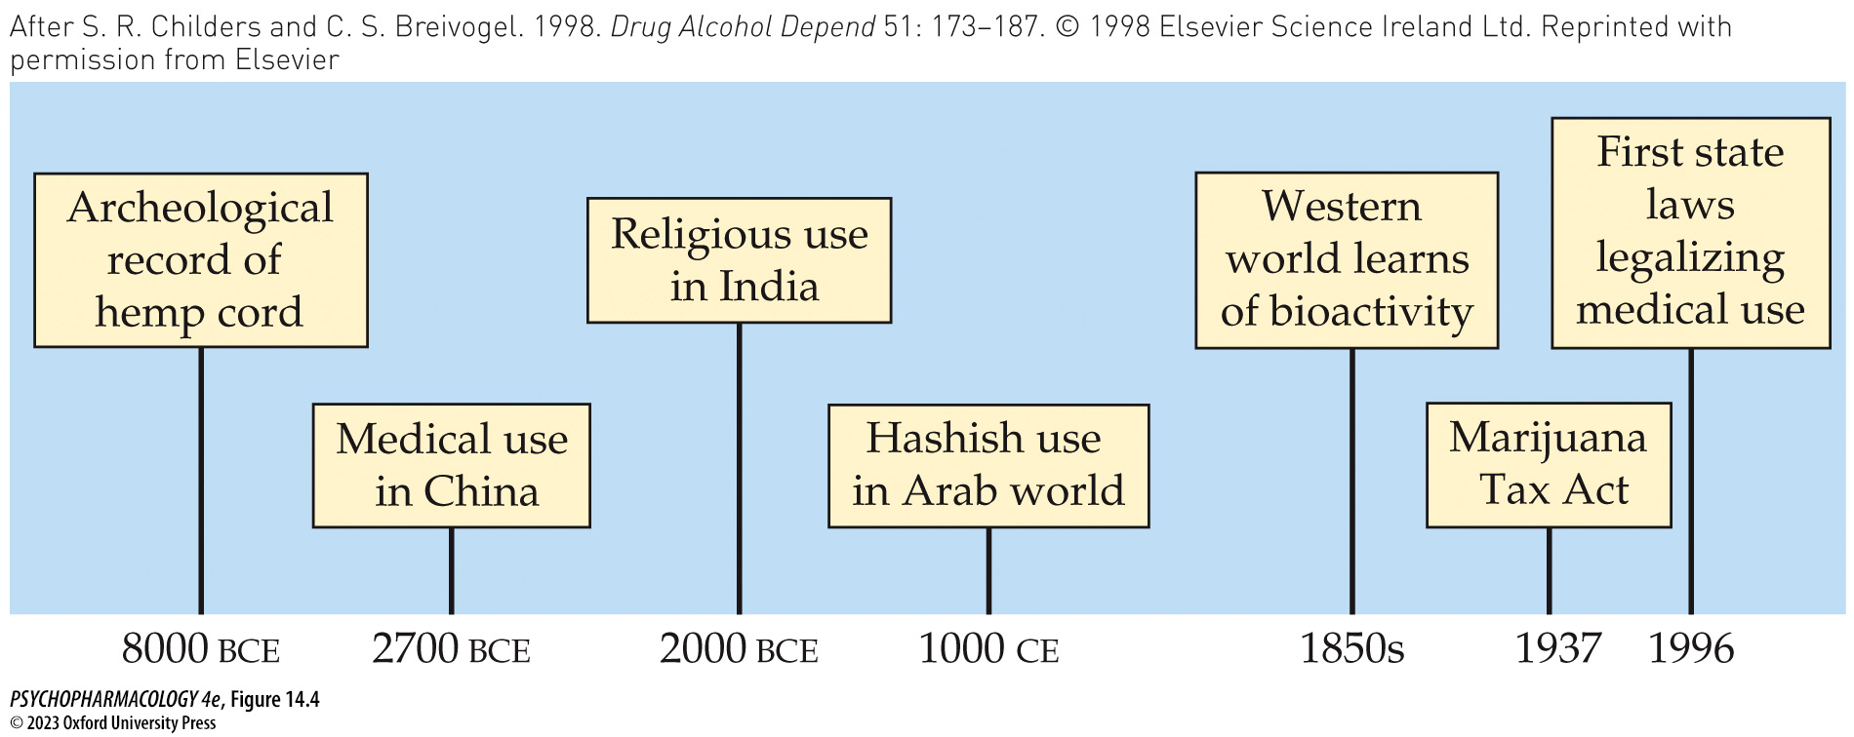
FIGURE 14.4 An 8000-year timeline of cannabis use around the world
Notes:
FIGURE 14.4 An 8000-year timeline of cannabis use around the world
(After S. R. Childers and C. S. Breivogel. 1998. Drug Alcohol Depend 51: 173–187. © 1998 Elsevier Science Ireland Ltd. Reprinted with permission from Elsevier.)

Slide 11
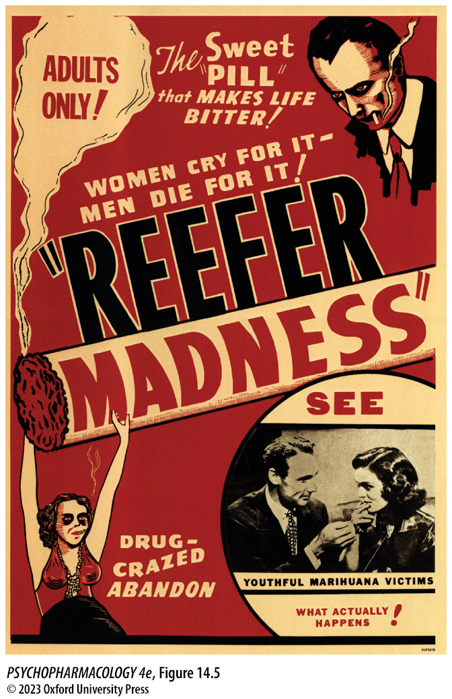
FIGURE 14.5 Poster advertising the 1936 film Reefer Madness
Notes:
FIGURE 14.5 Poster advertising the 1936 film Reefer Madness

Slide 12
Background, History, and
Basic Pharmacology of Cannabis and Marijuana (4 of 4)
Basic pharmacology of marijuana
Smoked THC is easily absorbed by the lungs and blood plasma levels rise quickly
Oral consumption: prolonged but poor absorption of THC, resulting in low and variable plasma concentrations due to degradation in the stomach and first pass metabolism
Metabolites are excreted in feces and urine; complete elimination is slow because THC persists in fat tissue – elimination half-life is 20-30 hours; THC-COOH can be detected in urine up to 2 weeks.
Notes:
Instructor Notes:

Slide 13
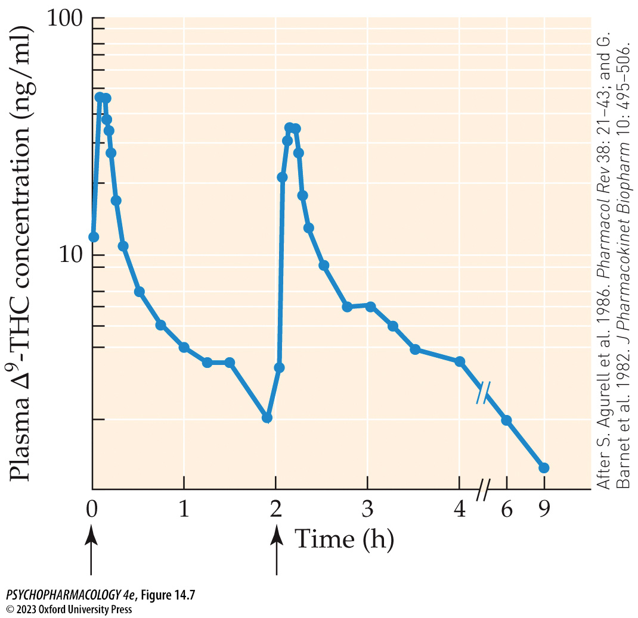
FIGURE 14.7 Mean time course of plasma THC concentrations
Notes:
FIGURE 14.7 Mean time course of plasma THC concentrations
Data were obtained from individuals who smoked a marijuana cigarette containing approximately 9 mg of THC at the two time points indicated by the arrows. (After S. Agurell et al. 1986. Pharmacol Rev 38: 21–43; and G. Barnet et al. 1982. J Pharmacokinet Biopharm 10: 495–506.)

Slide 14
Review of Learning Objectives (1 of 4)
14.1.1 Name the various forms of cannabis and their chemical constituents.
14.1.2 Discuss the history of cannabis.
14.1.3 Describe the basic pharmacology of THC when consumed as marijuana.

Slide 15
Mechanisms of Cannabinoid Action (1 of 10)
Cannabinoid effects are primarily mediated by cannabinoid receptors
Cannabinoid receptors are expressed in many brain areas; metabotropic
CB₁ receptors: principal cannabinoid receptor in the brain, also expressed in many other organs
CB₂ receptors: in immune system and brain – in microglia and neurons; CB₂ knockout mice show these receptors play a significant role in several behavioral functions.
Notes:
Instructor Notes:
CB receptors are metabatropic: coupling to G proteins G_{i} and G_{o}, leads to inhibition of cyclic adenosine monophosphate (cAMP) formation, inhibition of voltage-sensitive Ca²⁺ channels, and activation
of K⁺ channel opening

Slide 16
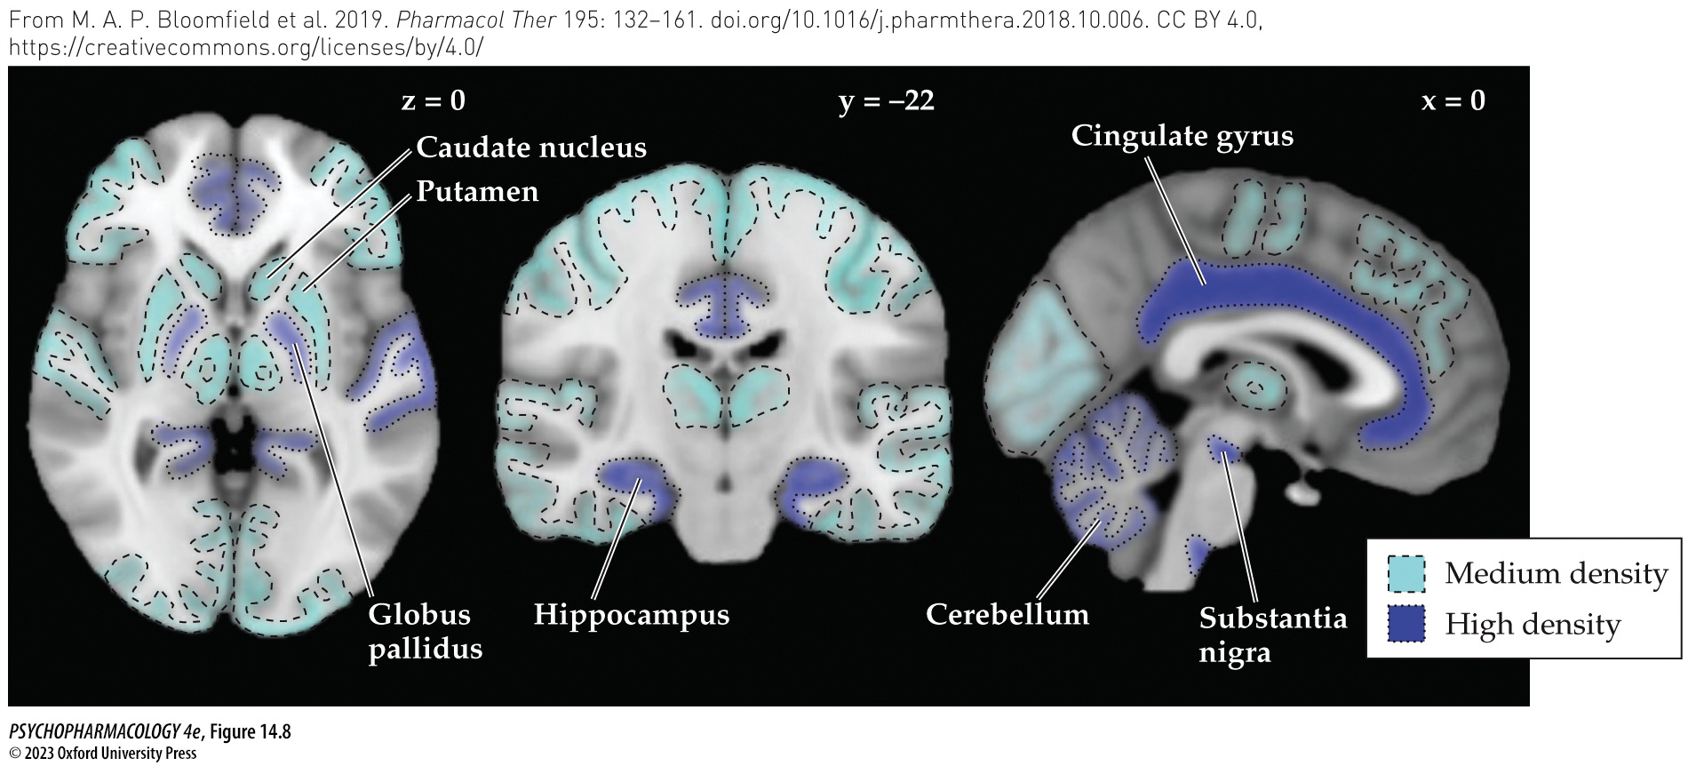
FIGURE 14.8 Areas of high and medium cannabinoid (CB₁) receptor levels in the human brain
Notes:
FIGURE 14.8 Areas of high and medium cannabinoid (CB₁) receptor levels in the human brain
CB₁ receptor levels determined by quantitative autoradiography were characterized as high or medium based on the relative amount of radioligand binding. Color-coded representations of these categories were then superimposed on axial/horizontal (left), coronal (middle), and sagittal (right) MRI images of the human brain. The coordinate shown above each image refers to the position of the MRI “slice” in a standard human brain atlas. Labels point to several brain areas expressing high or medium receptor levels that are known to play important roles in cannabinoid behavioral effects. Within the neocortex, the cingulate gyrus had a high level of receptor expression whereas other cortical areas had medium receptor levels. Not shown on any of the images is the amygdala, which had a high level of receptor expression.

Slide 17
Mechanisms of Cannabinoid Action (2 of 10)
Cannabinoid effects are primarily mediated by cannabinoid receptors
Presynaptic CB₁ receptors on nerve terminals have an inhibitory effect on transmitter release, including AcCh, DA, NE, 5-HT, GABA, and glutamate
CB receptors modulate gene expression by epigenetic changes and by activating MAP kinase system – plays an important role in synaptic plasticity, learning, and memory
Notes:
Instructor Notes:

Slide 18
Mechanisms of Cannabinoid Action (3 of 10)
Pharmacological and genetic studies reveal the functional roles of cannabinoid receptors
Synthetic selective CB₁ antagonists SR 141716A (rimonabant) and AM251 are used to study receptor function
THC in mice: four CB₁ receptor–mediated effects – reduced locomotor activity, hypothermia, catalepsy, and hypoalgesia
Lab animals also show biphasic anxiety behavior: reduced anxiety at low agonist doses (glutamate release), anxiogenesis at high doses (GABA release)
Notes:
Instructor Notes:

Slide 19
Mechanisms of Cannabinoid Action (4 of 10)
Pharmacological and genetic studies reveal the functional roles of cannabinoid receptors
Cannabis affects memory in lab animals in tests of memory; relies on activation of CB₁ receptors in the hippocampus
Interference with memory for spatial tasks involves inhibition of LTP in the hippocampal CA1 area
CB₂ receptor agonists in the immune system inhibit release of cytokines; alters migration of immune cells to sites of inflammatory reactions
Notes:
Instructor Notes:

Slide 20
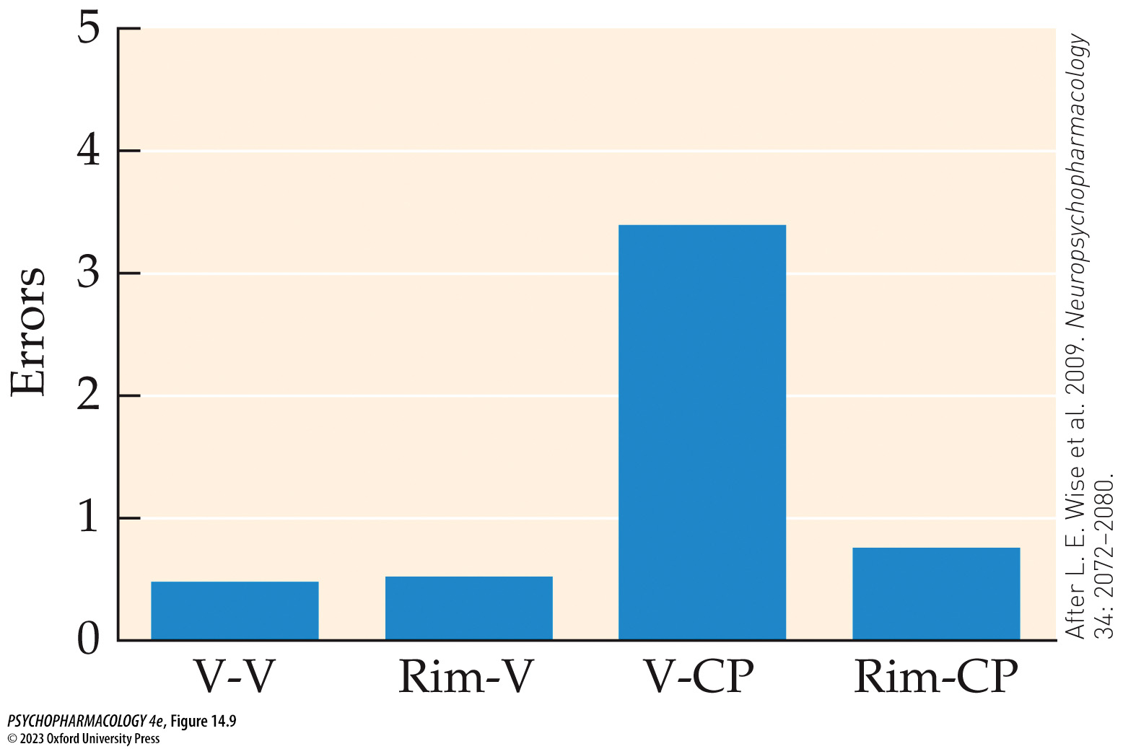
FIGURE 14.9 Hippocampal CB₁ receptors are responsible for cannabinoid-induced memory impairment
Notes:
FIGURE 14.9 Hippocampal CB₁ receptors are responsible for cannabinoid-induced memory impairment
Rats were trained to a high degree of performance on an eight-arm radial arm maze (see Chapter 4). After training was completed, intraperitoneal injection of the cannabinoid agonist CP-55,940 (0.05 mg/kg) along with a vehicle microinjection into the hippocampus (V-CP) produced a significant number of errors on the task compared with the control group (V-V), indicating an impairment in working memory. This effect was completely blocked by microinjection of rimonabant (0.06 μg) into the dorsal hippocampus (Rim-CP), whereas rimonabant by itself had no effect on maze performance (Rim-V). (After L. E. Wise et al. 2009. Neuropsychopharmacology 34: 2072–2080.)

Slide 21
Mechanisms of Cannabinoid Action (5 of 10)
Cannabidiol is not a cannabinoid receptor agonist
Cannabidiol (CBD): similar structure to THC; not intoxicating or dependence-producing
CBD can act as a negative allosteric modulator of CB₁ receptors
Inhibits breakdown of endogenous cannabinoids – enhances activity of the endocannabinoid system
Brain imaging shows THC promotes regional brain activation and enhanced local blood flow; CBD tends to decrease these processes
Notes:
Instructor Notes:

Slide 22
Mechanisms of Cannabinoid Action (6 of 10)
Endocannabinoids are cannabinoid receptor agonists synthesized by the body
Anandamide and 2-AG: lipid soluble – can’t be stored in vesicles; synthesized and released when needed, triggered by a rise in intracellular Ca²⁺ levels
Removed from extracellular fluid by an endocannabinoid membrane transporter
Anadamide is metabolized by fatty acid amide hydrolase (FAAH) 2-AG by monoacyl-glycerol lipase (MAGL)
2-AG is a full agonist at CB₁ and CB₂; anandamide is a partial agonist
Notes:
Instructor Notes:
Anandamide = Arachidonoyl ethanolamide (AEA); 2-AG = 2-arachidonoylglycerol
Both can also be metabolized by cyclooxygenase-2 (COX-2), an enzyme important in the process of inflammation. Repeated use of COX-2 inhibitors (nonsteroidal anti-inflammatory drugs,
or NSAIDs) for pain relief could alter endocannabinoid activity in the brain and elsewhere.

Slide 23
Mechanisms of Cannabinoid Action (7 of 10)
Endocannabinoids are cannabinoid receptor agonists synthesized by the body
Endocannabinoid signaling:
  Retrograde signaling: (2-AG)
  Non-retrograde signaling (anandamide)
  Neuron–astrocyte signaling
Endocannabinoids help regulate mood states, anxiety and fear, and reactions to stress – confirmed by rodent studies; the hippocampal endocannabinoid system is an important mediator of anxiety responses
Notes:
Instructor Notes:
Retrograde signaling: When the presynaptic cell is excitatory (glutamatergic), the effect is termed depolarization-induced suppression of excitation (DSE).
When the presynaptic cell is inhibitory (GABAergic), the effect is called depolarization-induced suppression of inhibition (DSI).

Slide 24
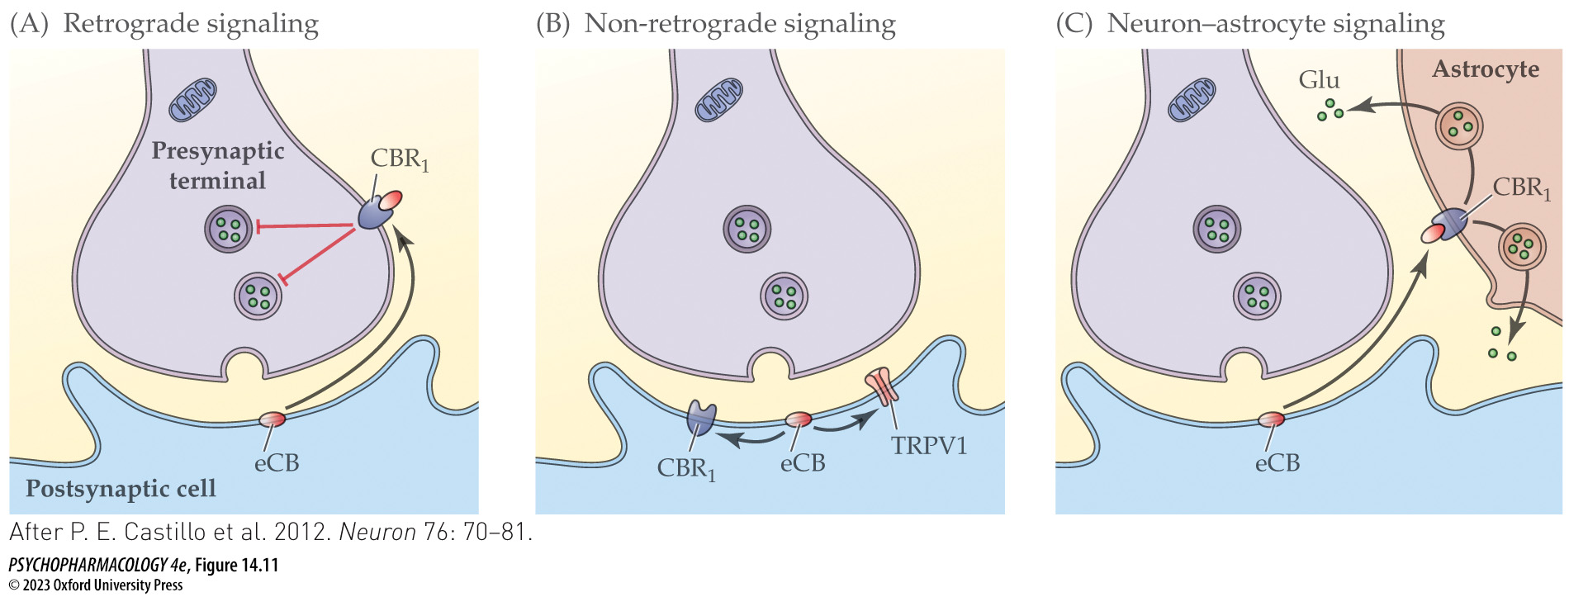
FIGURE 14.11 Mechanisms of endocannabinoid signaling
Notes:
FIGURE 14.11 Mechanisms of endocannabinoid signaling
(A) The most common and well-understood mechanism of endocannabinoid action is retrograde signaling. This mechanism involves release of the endocannabinoid (eCB), typically 2-AG, which diffuses from its site of synthesis in a dendritic spine to a presynaptic element where it activates CB₁ receptors (CBR₁). Such activation inhibits Ca²⁺-mediated vesicular neurotransmitter release. (B) In the second mechanism, an endocannabinoid such as anandamide remains within the dendritic spine to activate either postsynaptic CB₁ receptors or TRPV1 cation channels. (C) The third mechanism involves endocannabinoid activation of astrocyte CB₁ receptors, which has been shown to provoke glutamate (Glu) release from the cells. (After P. E. Castillo et al. 2012. Neuron 76: 70–81.)

Slide 25
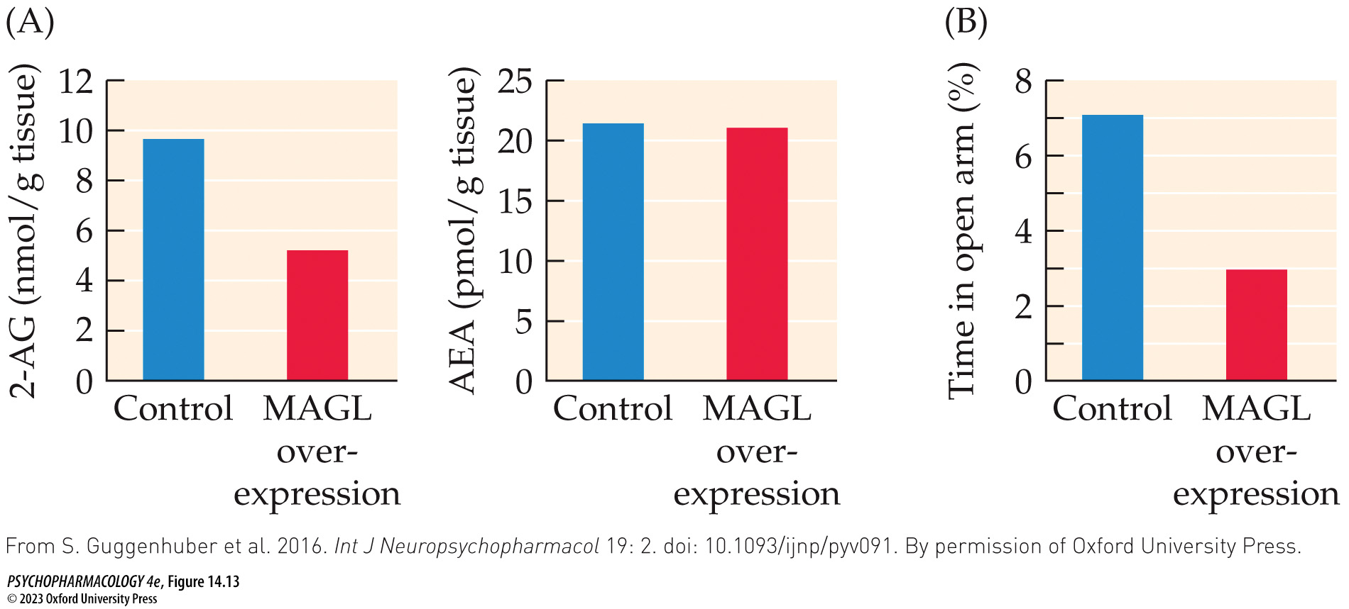
FIGURE 14.13 Biochemical, neurophysiological, and behavioral effects of enhancing 2-AG breakdown in hippo­campal glutamatergic neurons
Notes:
FIGURE 14.13 Biochemical, neurophysiological, and behavioral effects of enhancing 2-AG breakdown in hippo­campal glutamatergic neurons
The investigators used genetic methods to selectively enhance expression of MAGL (the main enzyme for 2-AG metabolism) in hippocampal glutamatergic neurons of mice. This led to a significant decrease in hippocampal 2-AG concentrations but no change in AEA (anandamide) (A). Note the thousand-fold greater unit of measure for 2-AG concentrations (nmol/g, or 10⁻⁹ moles per g) compared to AEA (pmol/g, or 10⁻¹² moles per g). The MAGL-overexpressing mice additionally showed a deficit in hippocampal DSE but no significant change in DSI (data not shown). When the animals were tested in the elevated plus-maze, overexpression of MAGL in the hippocampus led to increased anxiety-like behavior shown by less time spent in the open arms of the maze (B). (From S. Guggenhuber et al. 2016. Int J Neuropsychopharmacol 19: 2. doi: 10.1093/ijnp/pyv091. By permission of Oxford University Press.)

Slide 26
Mechanisms of Cannabinoid Action (8 of 10)
Endocannabinoids are cannabinoid receptor agonists synthesized by the body
Other endocannabinoid system functions:
Facilitating extinction of learned fear; deficient activity of the system may be a risk factor for PTSD
Regulation of eating behavior, hunger, and energy storage; CB₁ receptor antagonists reliably reduce food consumption
Pain regulation: both pain perception and the cognitive–affective responses to pain, especially neuropathic pain
Notes:
Instructor Notes:
Neuropathic pain: pain produced within the nervous system itself, not in direct response to a nociceptive (pain-inducing) stimulus like a stab wound or burn.

Slide 27
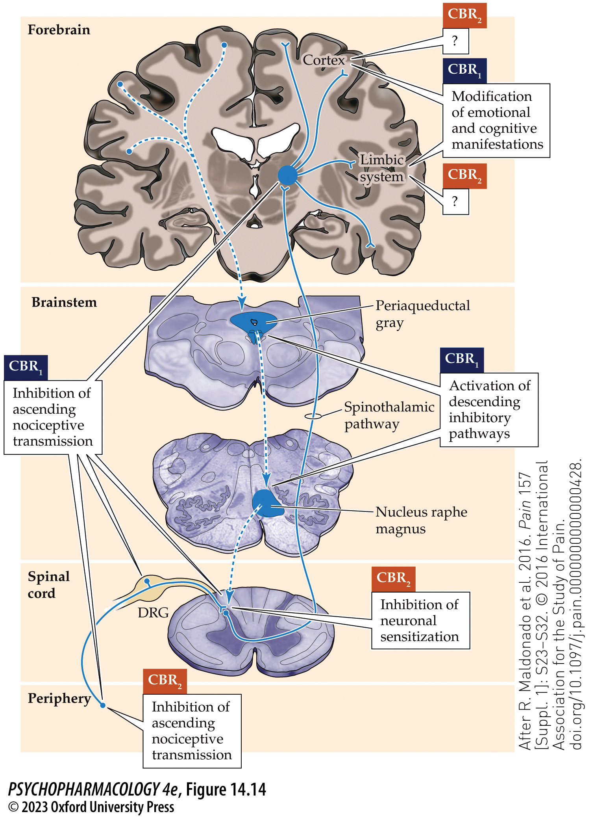
FIGURE 14.14 Location of CB₁ and CB₂ receptors involved in the modulation of pain perception (1)
Notes:
FIGURE 14.14 Location of CB₁ and CB₂ receptors involved in the modulation of pain perception
Both cannabinoid receptor subtypes (CBR₁ and CBR₂) participate in pain stimulus processing and perception at multiple levels of the nervous system. Activation of these receptors inhibits ascending pain information originating from peripheral nociceptive fibers, enhances descending pain-inhibitory pathways, and modulates the emotional and cognitive components of perceived pain. The presence of pain-modulating CB₂ receptors in the forebrain is currently uncertain, which accounts for the “?” in that part of the figure. DRG, dorsal root ganglia. (After R. Maldonado et al. 2016. Pain 157 [Suppl. 1]: S23–S32. © 2016 International Association for the Study of Pain. doi.org/10.1097/j.pain.0000000000000428.)

Slide 28
Mechanisms of Cannabinoid Action (9 of 10)
BOX 14.1 CLINICAL APPLICATIONS
Cannabinoid-Based Medications: THC, CBD, and Medical Marijuana
Four types of therapeutic cannabinoids:
  Pure synthetic THC: dronabinol (Marinol), nabilone (Cesamet); enhance appetite or combat nausea
  Cannabis extracts containing both THC and CBD: nabiximols (Sativex) neuropathic pain, muscle spasticity in MS
  CBD only extracts: Epidiolex reduce seizures in pediatric epilepsy
  Medical marijuana: treating a variety of conditions
CBD-containing preparations are also available over the counter
Notes:
Instructor Notes:

Slide 29
Mechanisms of Cannabinoid Action (10 of 10)
CLICKER QUESTION 1
Retrograde endocannabinoid signaling involves mostly
anandamide.
2-AG.
AM251.
glutamate.
Notes:
Instructor Notes:
Correct answer: b

Slide 30
Review of Learning Objectives (2 of 4)
14.2.1 Discuss the features of cannabinoid receptors, including their locations, signaling mechanisms, and functional roles.
14.2.2 Describe the mechanisms of action of CBD and how they differ from the mechanism of action of THC.
14.2.3 Describe the endocannabinoid system, including the identity of the major endocannabinoids, their synthesis and metabolism, and their functional effects.
14.2.4 Discuss the current status of cannabinoid-based medications, including medications containing pure cannabinoids, medical marijuana, and proposed therapeutic benefits of over-the-counter CBD formulations.

Slide 31
Acute Behavioral and Physiological Effects of Cannabinoids (1 of 6)
Cannabis consumption produces a dose-dependent state of intoxication
Subjective and behavioral effects of marijuana use can be separated into four stages: the “buzz,” the “high,” being “stoned,” and the “come-down.”
Physical responses include increased heart rate and blood pressure, increased hunger.
Effects of cannabinoid use vary depending on dose, frequency of use, characteristics of the user, the setting in which use occurs, and expectations
Notes:
Instructor Notes:

Slide 32
Acute Behavioral and Physiological Effects of Cannabinoids (2 of 6)
Cannabis consumption produces a dose-dependent state of intoxication
Effects of marijuana are at least partially mediated by CB₁ receptors; intoxication can be significantly inhibited by prior treatment with rimonabant
Adverse reactions: high doses can cause anxiety, transient psychotic symptoms, paranoia, violent behavior
Acute toxic reaction is manifested as CNS excitation or depression, tachycardia, and GI symptoms; rarely life-threatening
Notes:
Instructor Notes:

Slide 33
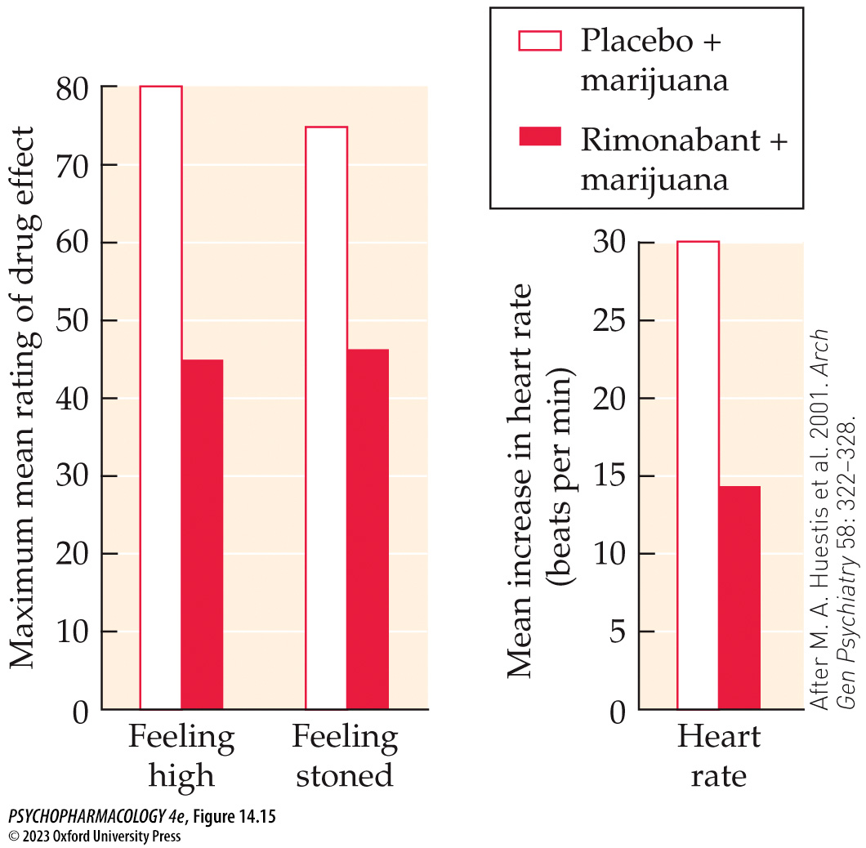
FIGURE 14.15 Reduction in the subjective and physiological effects of smoked marijuana by rimonabant pretreatment
Notes:
FIGURE 14.15 Reduction in the subjective and physiological effects of smoked marijuana by rimonabant pretreatment
Study participants received either 90 mg of the CB₁ cannabinoid receptor antagonist rimonabant or a placebo orally, after which they smoked either an active (2.64% THC content) or a placebo marijuana cigarette. Self-reported subjective effects and heart rate were measured over the next 65 minutes. The data shown represent the maximum mean effects of the active marijuana cigarette in the presence or absence of the receptor antagonist. (After M. A. Huestis et al. 2001. Arch Gen Psychiatry 58: 322–328.)

Slide 34
Acute Behavioral and Physiological Effects of Cannabinoids (3 of 6)
Marijuana use can lead to deficits in memory and other cognitive processes
Marijuana affects a variety of cognitive functions, including learning, memory, attention, impulse control, and decision making
Animal studies suggest that impairment of hippocampal-dependent learning/memory tasks is related to cannabinoid effects on the glutamatergic system within this brain area.
Also acutely impairs performance on complex psychomotor tasks; affects driving ability, especially if combined with alcohol
Notes:
Instructor Notes:

Slide 35
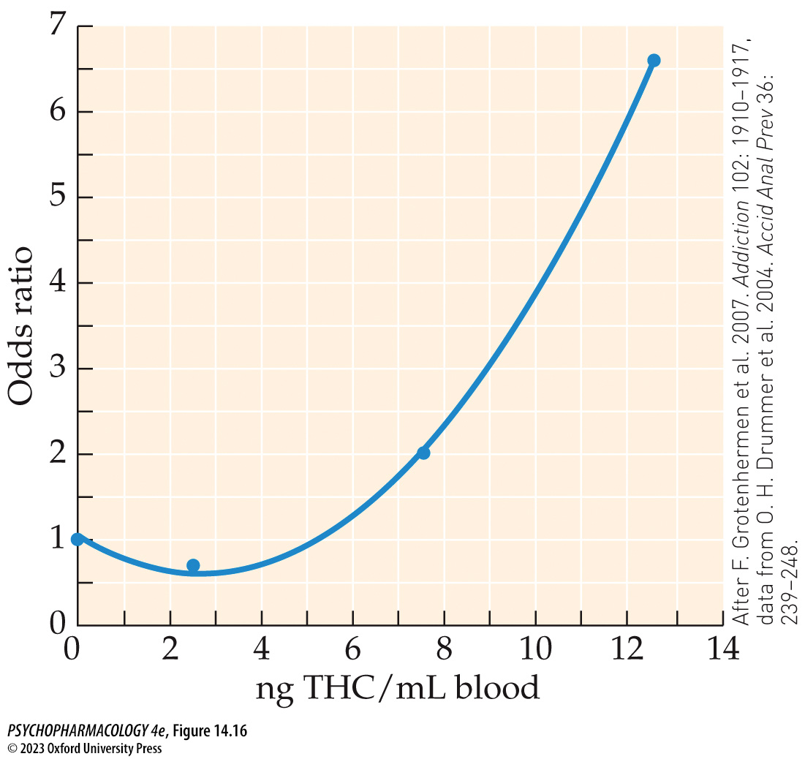
FIGURE 14.16 Estimated relationship between the driver’s blood THC concentration and the odds ratio of being in a motor vehicle accident
Notes:
FIGURE 14.16 Estimated relationship between the driver’s blood THC concentration and the odds ratio of being in a motor vehicle accident
Based on an Australian study of fatal motor vehicle accidents, the risk of being in such an accident (calculated as an odds ratio; OR) was mathematically related to whether THC could be measured in the driver’s blood post-mortem, and if so, the concentration level. The figure shows that for this study cohort, the OR was doubled by the time the concentration reached 8 ng/ml and continued to rise dramatically with increasing THC levels. Note that the small dip in the graphical function between 0 (no detectable THC) and the lowest THC level was produced by the curve-fitting function and probably has no real-world consequences. (After F. Grotenhermen et al. 2007. Addiction 102: 1910–1917, data from O. H. Drummer et al. 2004. Accid Anal Prev 36: 239–248.)

Slide 36
Acute Behavioral and Physiological Effects of Cannabinoids (4 of 6)
Rewarding and reinforcing effects of cannabinoids have been studied in both humans and animals
THC has less reward and reinforcing properties than opioids in animal tests, with the exception of squirrel monkeys
THC is a partial agonist at the CB₁ receptor; WIN55,212–2, a full agonist at the CB1 receptor, is self-administered by rodents
CB₁ receptors are involved in the brain’s reward system and interact with the endogenous opioid systems
Notes:
Instructor Notes:

Slide 37
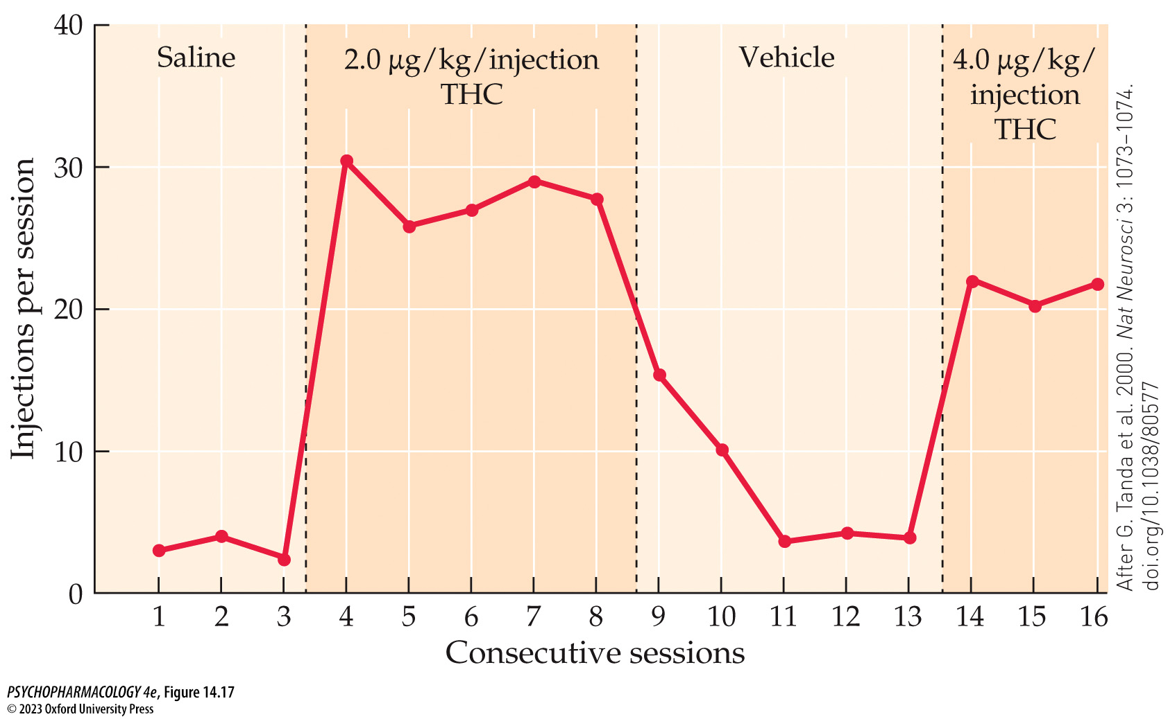
FIGURE 14.17 Acquisition of THC self-administration by squirrel monkeys
Notes:
FIGURE 14.17 Acquisition of THC self-administration by squirrel monkeys
Monkeys were initially trained in drug self-administration on a fixed-ratio-10 (FR-10) schedule using cocaine as the reinforcer (not shown). They were then switched to saline, which led to a nearly complete elimination of lever-pressing behavior. When THC (2.0 μg/kg/injection) was substituted for saline, lever pressing immediately increased to an amount sufficient to deliver approximately 30 drug injections per 1-hour session. Substitution with the vehicle again reduced operant responding until the active drug was made available once again. (After G. Tanda et al. 2000. Nat Neurosci 3: 1073–1074. doi.org/10.1038/80577.)

Slide 38
Acute Behavioral and Physiological Effects of Cannabinoids (5 of 6)
Rewarding and reinforcing effects of cannabinoids have been studied in both humans and animals
Cannabinoid reinforcement is dependent on CB₁ receptor-mediated activation of VTA dopaminergic cell firing and DA release in the NAcc
Mediated partly by presynaptic CB₁ receptors on GABAergic nerve terminals that synapse on the VTA neurons – suppressing GABA-mediated inhibition of cell firing.
Notes:
Instructor Notes:

Slide 39
Acute Behavioral and Physiological Effects of Cannabinoids (6 of 6)
CLICKER QUESTION 2
Why is THC less reinforcing than opioids?
It interacts closely with the endogenous opioid system.
It stimulates dopamine release in the Nacc.
THC is only a partial agonist at the CB1 receptor.
THC is an antagonist at the CB1 receptor.
Notes:
Instructor Notes:
Correct answer: c

Slide 40
Review of Learning Objectives (3 of 4)
14.3.1 Describe the subjective features of cannabis intoxication.
14.3.2 Discuss the short-term effects of marijuana use on cognitive function.
14.3.3 Describe evidence for cannabinoid reinforcement and its underlying mechanisms.

Slide 41
Cannabis Use, Misuse, and the Effects of Chronic Cannabis Exposure (1 of 11)
Global cannabis/marijuana use, initiation of use, and subsequent age-related changes in use are well documented
Cannabis is the most widely used illicit drug in the world and in the U.S.
First use typically occurs in adolescence and peaks during young adulthood
Predictors of early use: sensation seeking, impulsiveness, poor behavioral control, rebelliousness, low academic motivation, prior experience with alcohol and tobacco
Notes:
Instructor Notes:

Slide 42
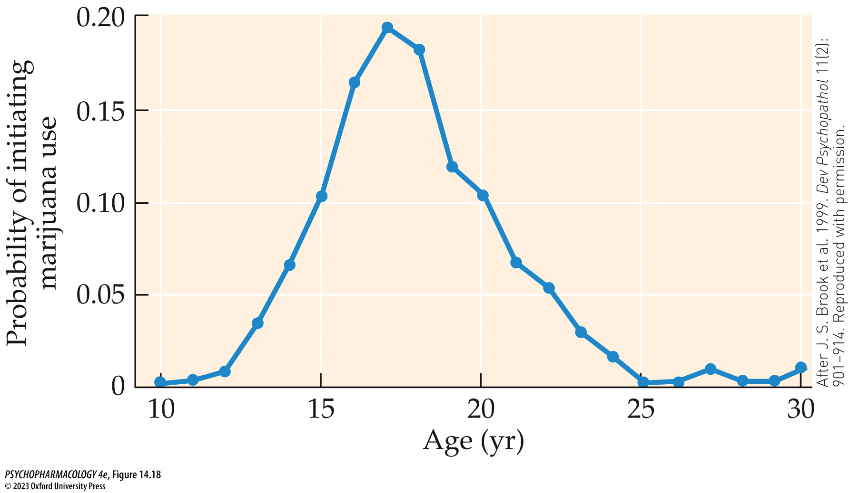
FIGURE 14.18 Probability of initiating marijuana use as a function of age
Notes:
FIGURE 14.18 Probability of initiating marijuana use as a function of age
(After J. S. Brook et al. 1999. Dev Psychopathol 11(2): 901–914. Reproduced with permission.)

Slide 43
Cannabis Use, Misuse, and the Effects of Chronic Cannabis Exposure (2 of 11)
Chronic use of cannabis can lead to the development of a cannabis use disorder
DSM-5 contains diagnostic criteria for cannabis intoxication, withdrawal, and cannabis use disorder (CUD)
CUD risk factors: onset of use before age 16, frequency of use, co-use of tobacco, being male – but women tend to have more severe symptoms and progress faster
Risk is also influenced by biological and psychosocial variables including comorbid mood, anxiety, or personality disorders, and the legal status of cannabis availability.
Notes:
Instructor Notes:

Slide 44
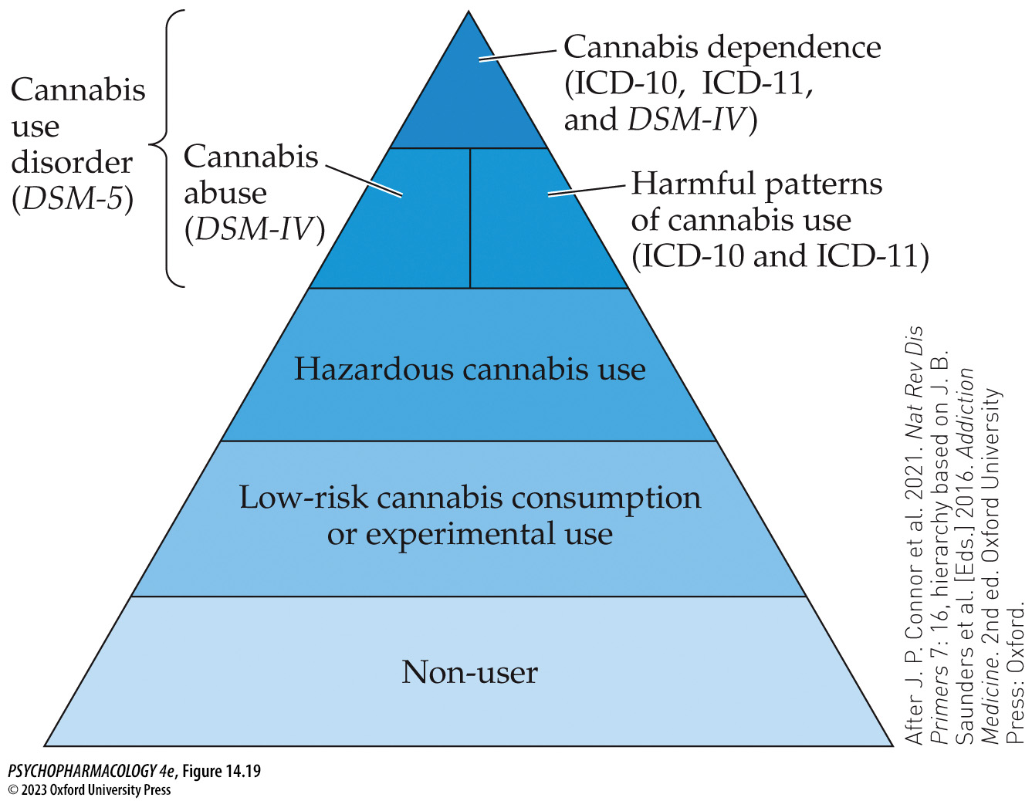
FIGURE 14.19 Classification systems of cannabis use and misuse
Notes:
FIGURE 14.19 Classification systems of cannabis use and misuse
As depicted in the figure, most people do not use cannabis. Experimental or occasional use is thought to pose relatively little risk to health. Increased levels of use have been associated with demonstrable risks to physical and/or mental health. Finally, high levels of use pose the greatest health risks and may cause the individual to meet diagnostic criteria for clinical disorders of cannabis use according to the DSM and ICD. (After J. P. Connor et al. 2021. Nat Rev Dis Primers 7: 16, hierarchy based on J. B. Saunders et al. [Eds.] 2016. Addiction Medicine. 2nd ed. Oxford University Press: Oxford.)

Slide 45
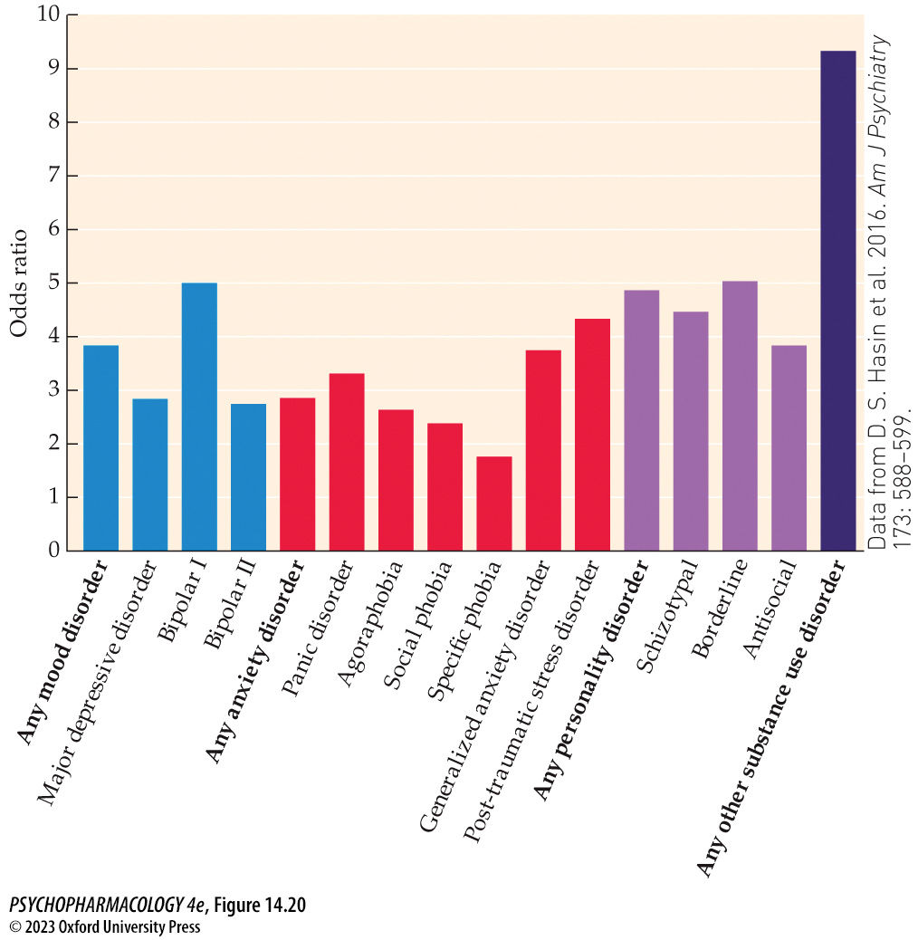
FIGURE 14.20 Odds ratio of having a comorbid psychiatric condition for individuals with CUD
Notes:
FIGURE 14.20 Odds ratio of having a comorbid psychiatric condition for individuals with CUD
These odds ratios show the difference in risk of having the indicated condition when individuals with and without CUD are compared. (Data from D. S. Hasin et al. 2016. Am J Psychiatry 173: 588–599.)

Slide 46
Cannabis Use, Misuse, and the Effects of Chronic Cannabis Exposure (3 of 11)
Chronic use of cannabis can lead to the development of a cannabis use disorder
Regular cannabis users showed tolerance to the acute intoxicating effects, impairment of cognitive function, feelings of anxiety induced by higher doses, physiological changes such as tachycardia
Tolerance appears to involve a combination of desensitization and down-regulation of CB₁ receptors; demonstrated in animal studies and brain imaging
Notes:
Instructor Notes:

Slide 47
Cannabis Use, Misuse, and the Effects of Chronic Cannabis Exposure (4 of 11)
Chronic use of cannabis can lead to the development of a cannabis use disorder
Development of CUD and associated tolerance also includes reduced glutamate levels in the anterior cingulate cortex and striatum and impaired striatal dopaminergic functioning.
These changes may partly underlie the cognitive deficits and abnormal mood and motivation observed in CUD.
Notes:
Instructor Notes:

Slide 48
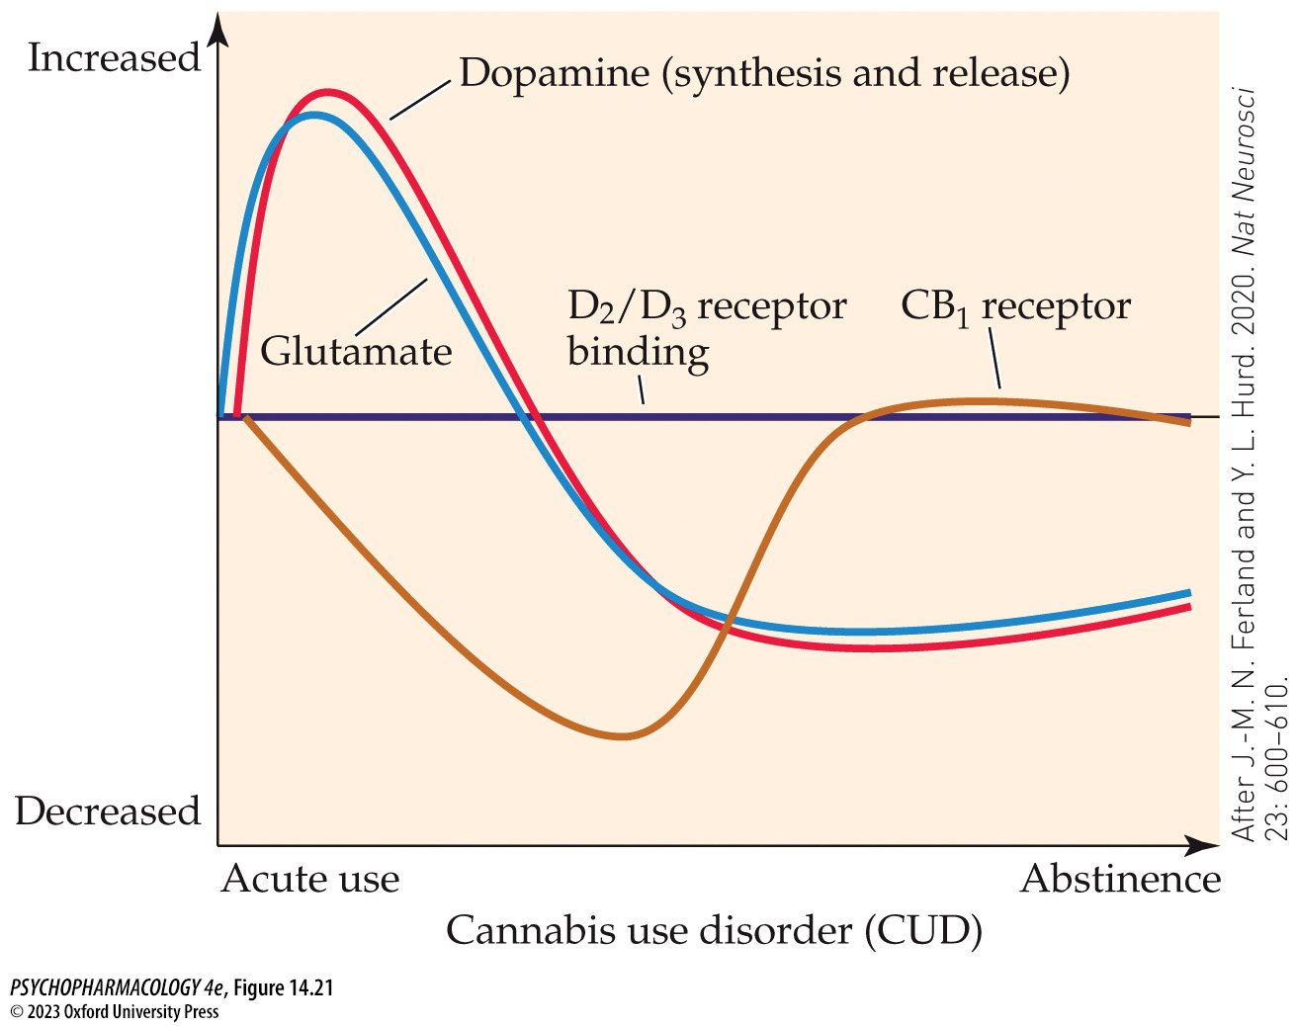
FIGURE 14.21 Neurochemical changes related to acute cannabis use, chronic use and the development of CUD, and abstinence from use
Notes:
FIGURE 14.21 Neurochemical changes related to acute cannabis use, chronic use and the development of CUD, and abstinence from use
Brain imaging studies have demonstrated that in occasional cannabis users or non-users, acute cannabis exposure causes increased striatal DA synthesis and release, and increased glutamate levels in the dorsal striatum and anterior cingulate cortex. With chronic cannabis use leading to CUD, these acute effects are reversed, resulting in below-normal DA synthesis and release and reduced glutamate levels. CB₁ receptors throughout the brain are also down-regulated, contributing to cannabis tolerance. During abstinence, the reduction in CB₁ receptors rapidly normalizes but not the DA- or glutamate-related changes. Striatal D₂/D₃ receptors do not seem to be affected in CUD. (After J.-M. N. Ferland and Y. L. Hurd. 2020. Nat Neurosci 23: 600–610.)

Slide 49
Cannabis Use, Misuse, and the Effects of Chronic Cannabis Exposure (5 of 11)
Chronic use of cannabis can lead to the development of a cannabis use disorder
Withdrawal symptoms are similar to those of nicotine; symptoms can be relieved with smoked or oral THC
Absence of symptoms in rodent studies was due to long elimination half-life of THC; when rimonabant was used to abruptly block receptors (precipitated withdrawal), withdrawal symptoms were observed
Reduced DA cell firing, increased CRF release, and other changes could contribute to symptoms of cannabis withdrawal in human users.
Notes:
Instructor Notes:

Slide 50
Cannabis Use, Misuse, and the Effects of Chronic Cannabis Exposure (6 of 11)
Chronic use of cannabis can lead to the development of a cannabis use disorder
Treatment of CUD may involve cognitive behavioral therapy, relapse prevention training, and/or motivational enhancement therapy
Contingency management programs
Medications have not proven to reliably improve long-term abstinence rates
Agonist substitutions have been tested, including dronabinol, nabilone, and nabiximols
Notes:
Instructor Notes:

Slide 51
Cannabis Use, Misuse, and the Effects of Chronic Cannabis Exposure (7 of 11)
Chronic cannabis use can lead to adverse behavioral, neurobiological, and health effects
Long-term cannabis use leads to impairment in many cognitive domains when assessed following 2 weeks of abstinence
Persistent deficits are most likely to occur if regular, heavy cannabis use begins early in adolescence
Longitudinal studies find a significant relationship between early cannabis use and later educational and/or occupational achievements
Drug-related motivational changes may have a negative impact on performance in the classroom (amotivational syndrome) but personality characteristics could be a cause, not a consequence, of marijuana use
Notes:
Instructor Notes:

Slide 52
TABLE 14.1 Summary of Acute and Chronic Effects of Cannabinoid Exposure on Cognitive Processes
Acute effects
  Impaired verbal learning and memory
  Impaired working memory
  Impaired attention (task- and dose-dependent)
  Impaired inhibitory control and (to a lesser extent) other executive functions
  Impaired psychomotor function
Chronic effects
  Impaired verbal learning and memory
  Impaired attention; attentional bias
  Possibly impaired psychomotor function
  Possibly impaired executive function (depending on frequency of use and age of onset)
Recovery of function with abstinence
  Likely persistent effects on attention and psychomotor function
  Possibly persistent effects on verbal learning and memory (insufficient and mixed evidence)
Source: After S. J. Broyd et al. 2016. Biol Psychiatry 79: 557–567.
Note: Some acute cannabinoid effects are dependent on the specific task and dose, whereas some chronic effects depend on frequency of use and age of onset of cannabis use. Lesser reliability of findings is denoted by terms such as possibly and likely.
Notes:
TABLE 14.1 Summary of Acute and Chronic Effects of Cannabinoid Exposure on Cognitive Processes

Slide 53
Cannabis Use, Misuse, and the Effects of Chronic Cannabis Exposure (8 of 11)
Chronic cannabis use can lead to adverse behavioral, neurobiological, and health effects
Brain imaging studies show lower gray matter volume in some areas – could reflect changes in dendritic arborization and/or synaptic connectivity
Functional MRI and EEG show brain areas that are differentially activated in cannabis users vs controls
Rodent studies: chronic dosing of adolescents with THC or synthetic cannabinoids results in numerous changes in the glutamatergic, GABAergic, and dopaminergic systems
Notes:
Instructor Notes:

Slide 54
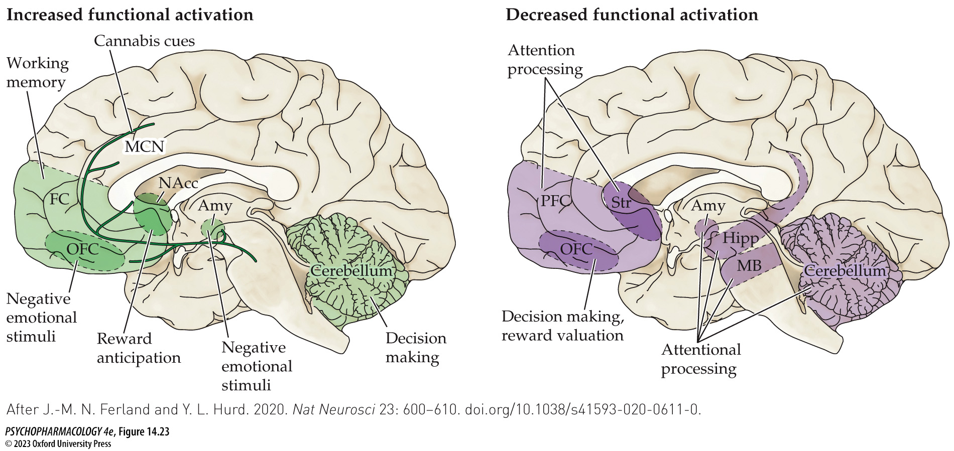
FIGURE 14.23 Altered task-dependent functional brain activity in CUD compared to controls
Notes:
FIGURE 14.23 Altered task-dependent functional brain activity in CUD compared to controls
Studies compared regional brain activation in chronic cannabis users with controls during performance of specific cognitive or emotional tasks. Task-dependent activation patterns were measured using fMRI or EEG. The figure depicts summary results in which the indicated brain area showed either increased task-dependent activation in the cannabis-using group (left) or decreased activation in that group (right). Amy, amygdala; FC, frontal cortex; Hipp, hippocampus; MB, midbrain; MCN, mesocortico­limbic network (corresponding to the combined mesolimbic and mesocortical dopaminergic pathways); NAcc, nucleus accumbens; OFC, orbitofrontal cortex; PFC, prefrontal cortex; Str, striatum. (After J.-M. N. Ferland and Y. L. Hurd. 2020. Nat Neurosci 23: 600–610. doi.org/10.1038/s41593-020-0611-0.)

Slide 55
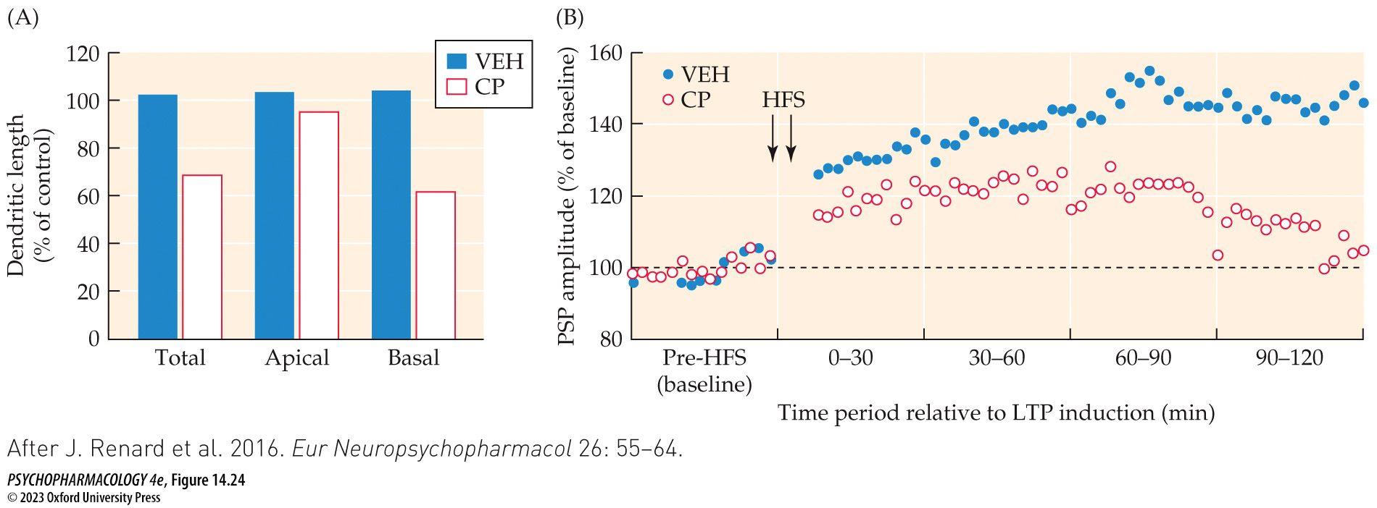
FIGURE 14.24 Chronic treatment of adolescent rats with CP-55,940 reduced PFC dendritic length and impaired LTP at hippocampal–PFC synapses
Notes:
FIGURE 14.24 Chronic treatment of adolescent rats with CP-55,940 reduced PFC dendritic length and impaired LTP at hippocampal–PFC synapses
Male rats were given daily IP injections of CP-55,940 (CP) or drug vehicle (VEH) from postnatal day 29 through day 50. Doses were 0.15 mg/kg for the first 7 days, 0.20 mg/kg for the next 7 days, and 0.30 mg/kg for the last 7 days. No further treatments were given after day 50. (A) On postnatal day 92, some of the CP-55,940–treated and control rats were killed and their brains were stained to visualize dendritic arbors using a modification of the Golgi technique (see Chapter 2). Measurement of dendritic length of cortical layer 2/3 pyramidal neurons in the PFC revealed a significant reduction in basal dendrites and in total dendritic length (basal + apical). (B) Separate groups of rats at day 92 or later were anesthetized for electrophysiological analysis of long-term potentiation (LTP) at hippocampal–PFC synapses that was induced by high-frequency stimulation (HFS). LTP in the drug-treated rats (measured as postsynaptic potential [PSP] amplitude) was impaired when compared with vehicle-treated animals. (After J. Renard et al. 2016. Eur Neuropsychopharmacol 26: 55–64.)

Slide 56
Cannabis Use, Misuse, and the Effects of Chronic Cannabis Exposure (9 of 11)
Chronic cannabis use can lead to adverse behavioral, neurobiological, and health effects
Marijuana smoke contains irritants, carbon monoxide, and carcinogens; risk of respiratory problems e.g., chronic bronchitis
Increased risk of serious cardiovascular and cerebrovascular disorders
Possible adverse effects on reproduction and immune function (inconclusive evidence)
Increased risk for developing depression, anxiety disorders, or psychosis (e.g., schizophrenia) has been correlated with early and heavy cannabis use
THC can cross the placenta and move into breast milk and may affect development
Notes:
Instructor Notes:

Slide 57
Cannabis Use, Misuse, and the Effects of Chronic Cannabis Exposure (10 of 11)
BOX 14.2 OF SPECIAL INTEREST
Beyond Cannabis: The Rise of Synthetic Cannabinoids
Synthetic designer cannabinoids (K2 or Spice): hundreds have been synthesized
Produced in powdered form that is solubilized and sprayed on herbs or other plants, then smoked or vaporized
Activate both CB₁ and CB₂ receptors but are more potent than THC; most are full agonists; more likely to cause toxic reactions
Notes:
Instructor Notes:

Slide 58
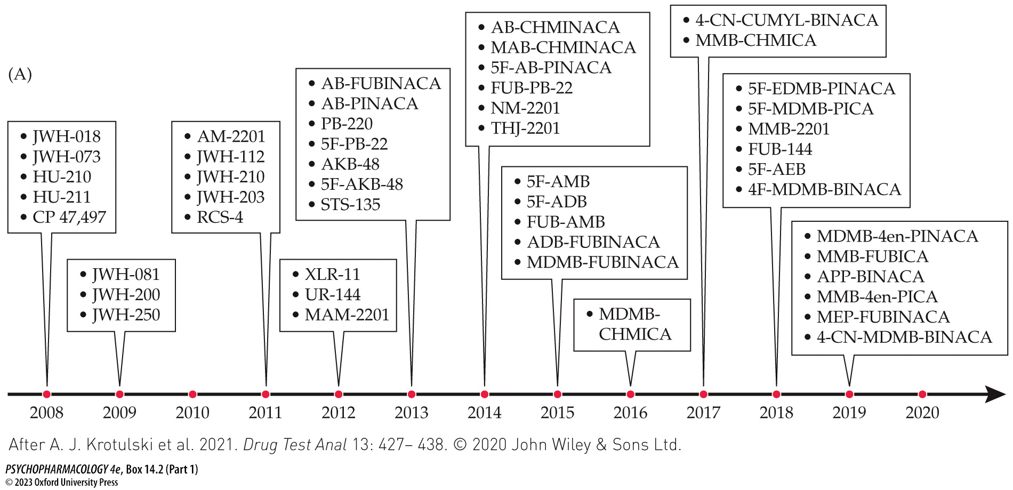
Box 14.2 Of Special Interest: Beyond Cannabis: The Rise of Synthetic Cannabinoids (Part 1)
Notes:
Box 14.2 Of Special Interest: Beyond Cannabis: The Rise of Synthetic Cannabinoids
FIGURE A Timeline of introduction of new synthetic cannabinoids in the United States from 2008 through 2019
At present, there is no systematic nomenclature system for synthetic cannabinoids, which is the reason for the confusing variety of names shown in the figure. To some extent, however, drug name similarities can be seen that indicate particular families of compounds in which modifications have been made to the basic structure of the drug while retaining cannabinoid agonist activity (e.g., JWH series, FUB series, MDMB series). The information presented was provided by the U.S. Drug Enforcement Administration (DEA). (After A. J. Krotulski et al. 2021. Drug Test Anal 13: 427– 438. © 2020 John Wiley & Sons Ltd.)

Slide 59
Cannabis Use, Misuse, and the Effects of Chronic Cannabis Exposure (11 of 11)
CLICKER QUESTION 3
Which of the following has been found in brain imaging studies of long-term cannabis users?
Reduced gray matter volume in several brain areas
Up-regulation of central CB1 receptors in many areas of the brain
Reduced DA cell firing in the mesolimbic system
Notes:
Instructor Notes:
Correct answer: a

Slide 60
Review of Learning Objectives (4 of 4)
14.4.1 (a) Describe the characteristics of recreational cannabis use, (b) cannabis use disorder (CUD), and (c) the treatment of CUD.
14.4.2 Discuss the issues around marijuana legalization and its potential consequences.
14.4.3 Describe the adverse behavioral, neurobiological, and health effects of chronic cannabis use.
14.4.4 Describe the key differences between cannabis and synthetic cannabinoids.

